Slide 1
Feane’s Restaurant Management System
Built using Python and Django

Slide 2
Presented by:
Ankita Swami,
Anushree Oimbe, Shubhangi More
Date: 24 April 2025

Slide 3
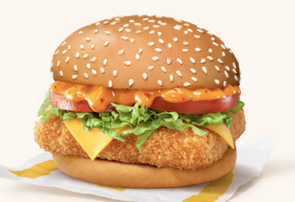
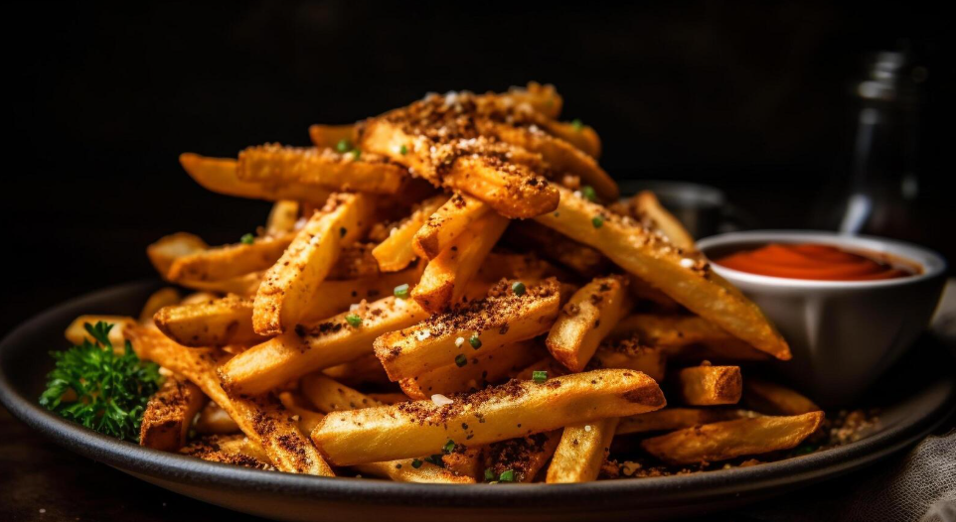
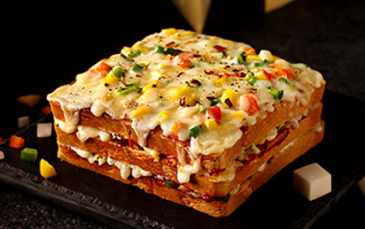
Project Overview
Goal :
Feane’s Restraurant
A web application to streamline restaurant operations such as menu browsing, order placement, and admin control.

Slide 4
01
Interactive menu display
02
User registration & login
03
Order placement system
Key Features :
04
Admin dashboard to manage orders

Slide 5
TECH STACK
BACKEND :
Python (3.x)
Django Framework
FRONTEND :
HTML
CSS
Bootstrap
DATABASE :
SQLite (Django ORM)
TOOLS :
Django Admin
Django Template Engine

Slide 6
ARCHITECTURE
Project Root
├── manage.py
├── restaurant/
│ ├── __init__.py
│ ├── models.py
│ ├── views.py
│ ├── urls.py
│ ├── templates/
│ └── static/
This structure defines the Django app including models, views, templates, and static files

Slide 7
FUNCTIONAL MODULES
User Module:
Register, Login, Logout
Menu Module:
Dynamic food item display
Order Module:
Place orders, view status
Admin Module:
Add/edit menu items, view/manage orders

Slide 8
MODELS
Core Models:
Menu Item:
Stores dish names, prices, categories
Order:
Links to User, includes items and status
User:
Built-in Django user model for authentication

Slide 9
FLOWCHARTS
Start → Home Page
↓
Login/Register
↓
View Menu
↓
Place Order
↓
Admin Receives Order
↓
Order Prepared & Marked as Complete
↓
User Views Confirmation

Slide 10
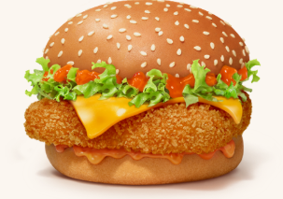
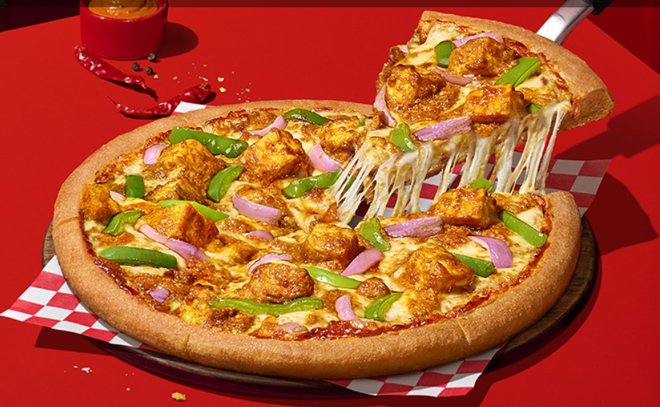
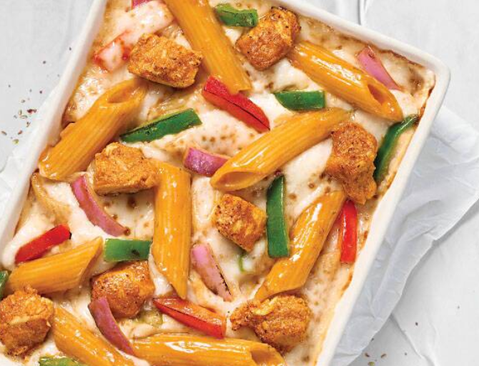
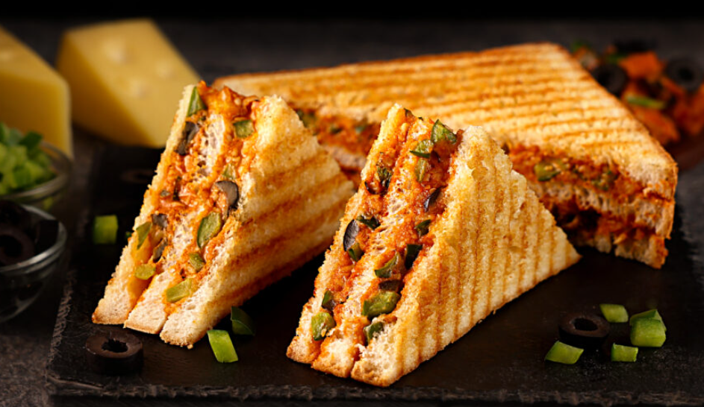
Hot Selling
BURGER
PIZZA
PASTA
SANDWICHES
A cheeseburger is a hamburger with one or more slices of melted cheese on top of the meat patty, added near the end of the cooking time
Made with a characteristically thick, braided crust topped with heavy amounts of sauce and cheese.
Pasta can be eaten by everyone – kids & grown-ups!
The club sandwich is a classic for a reason. Because it's a double-decker

Slide 11
Models Overview
Core Models:
Menu Item:
Stores dish names, prices, categories
Order:
Links to User, includes items and status
User:
Built-in Django user model for authentication

Slide 12
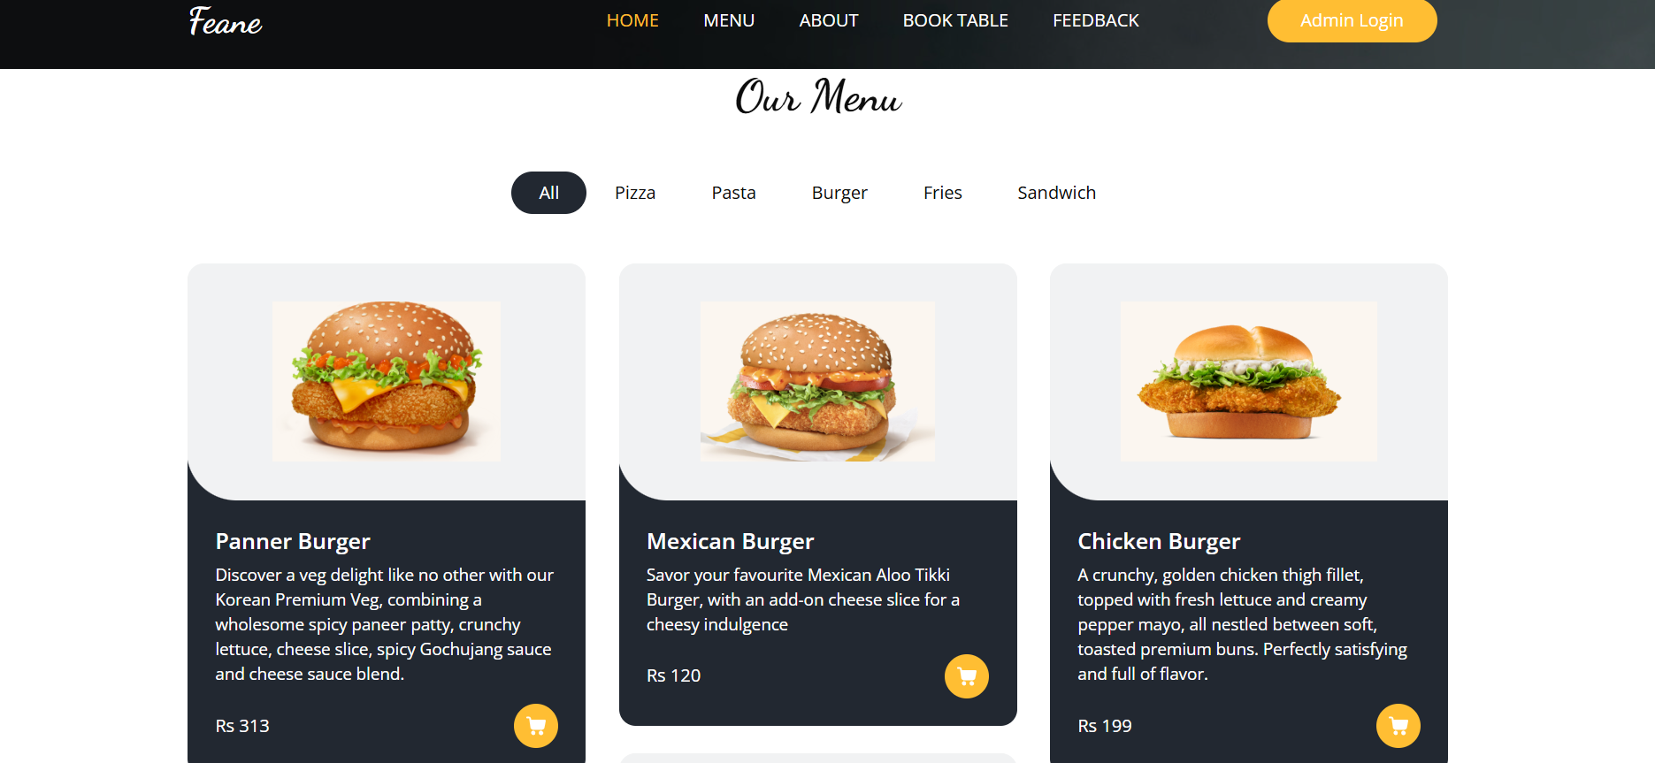
What we serve?

Slide 13
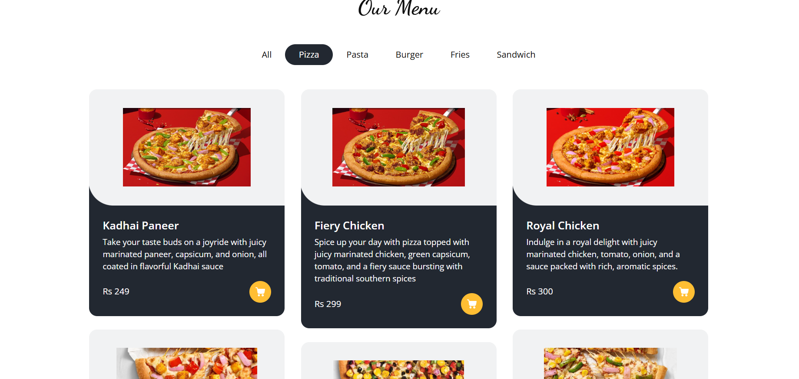
What we serve?

Slide 14
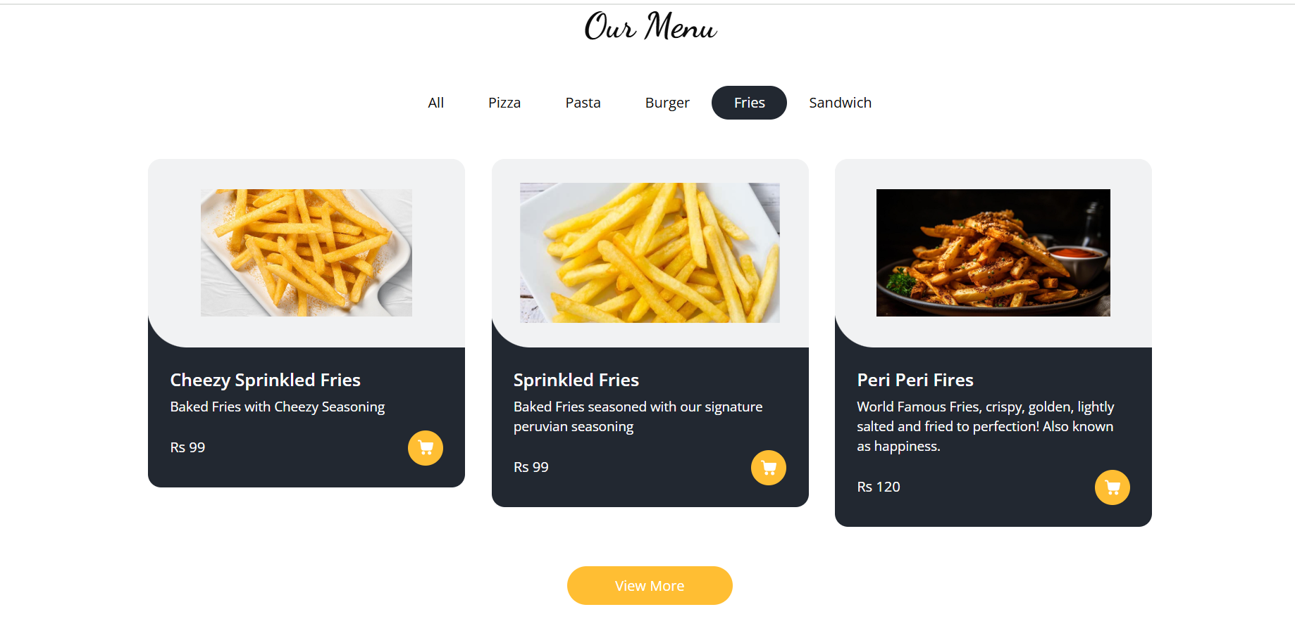
What we serve?

Slide 15
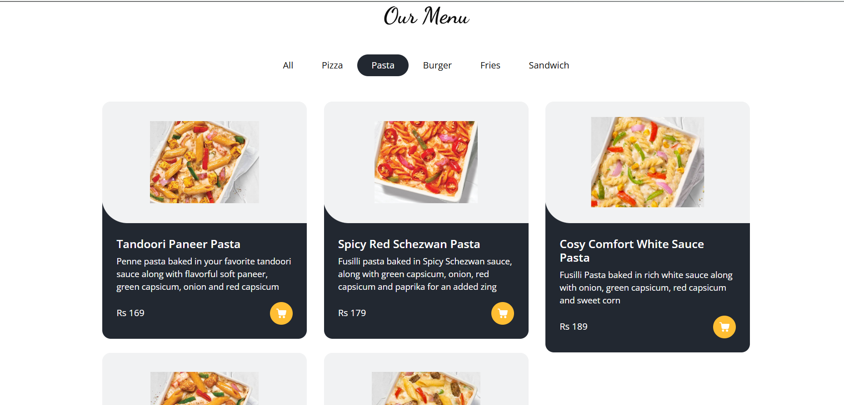
What we serve?

Slide 16
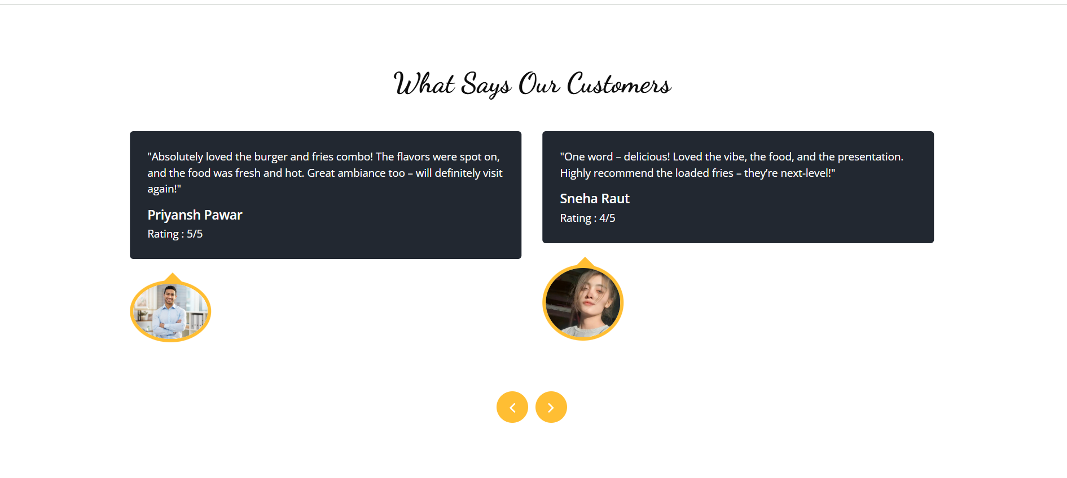
.

Slide 17
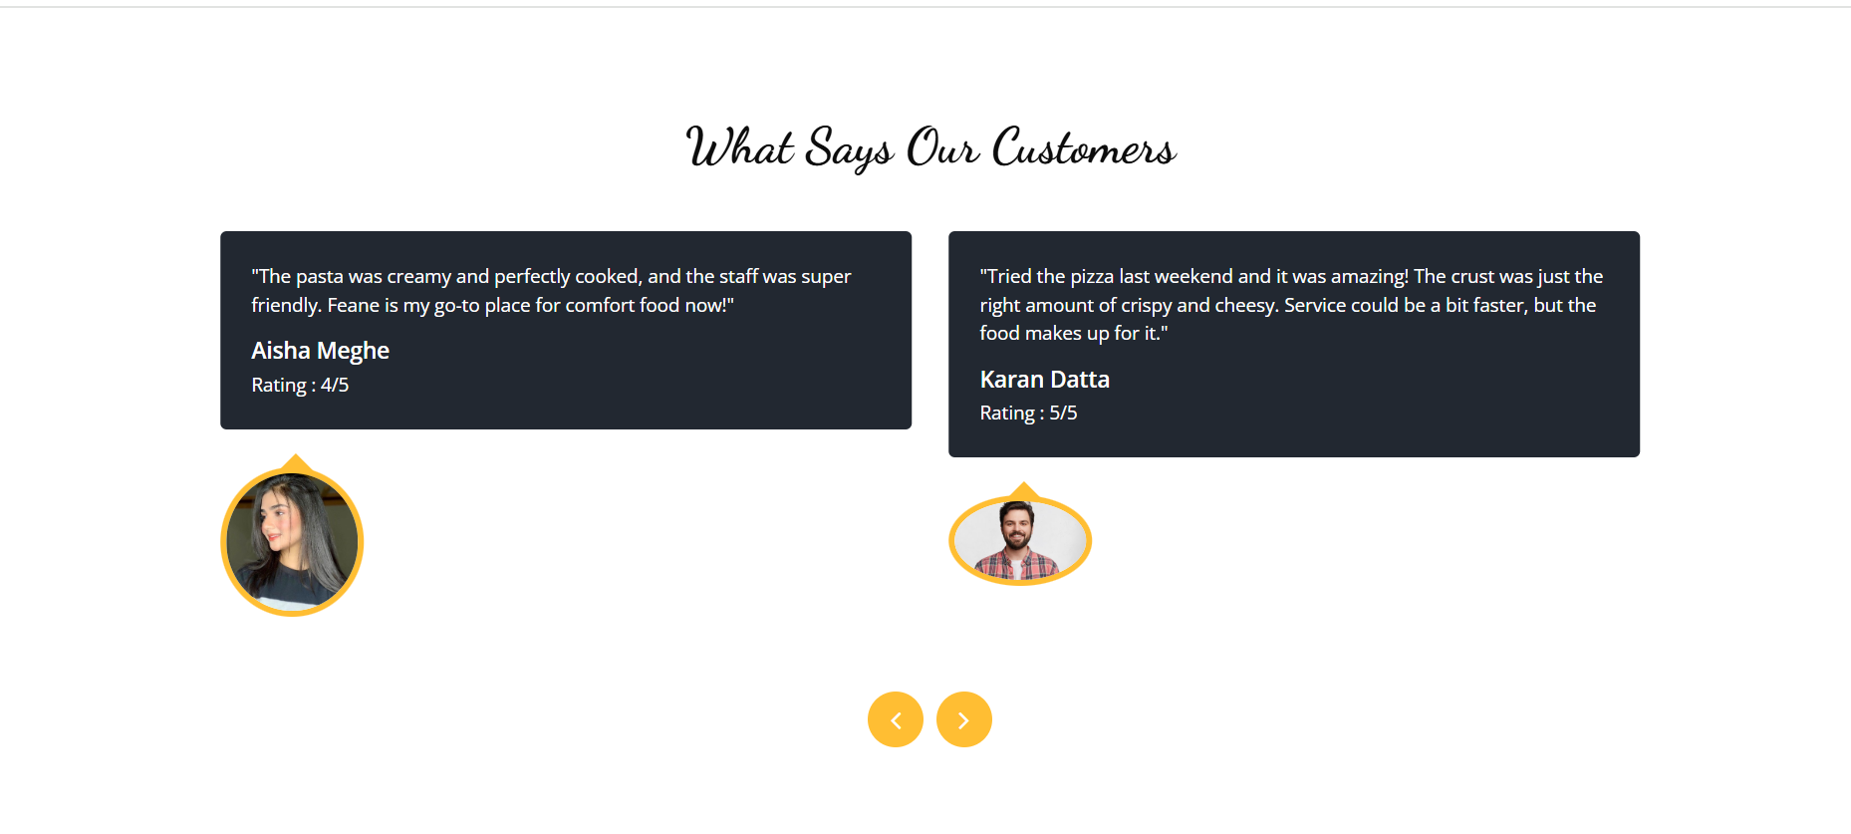
.

Slide 18
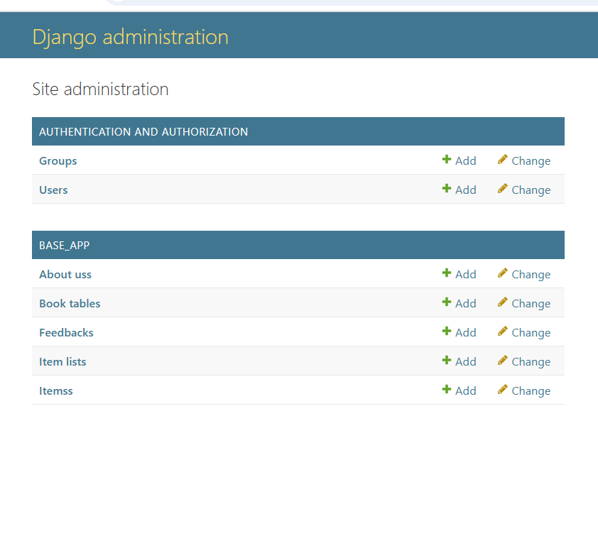
Screenshots – Admin Panel Login Page

Slide 19
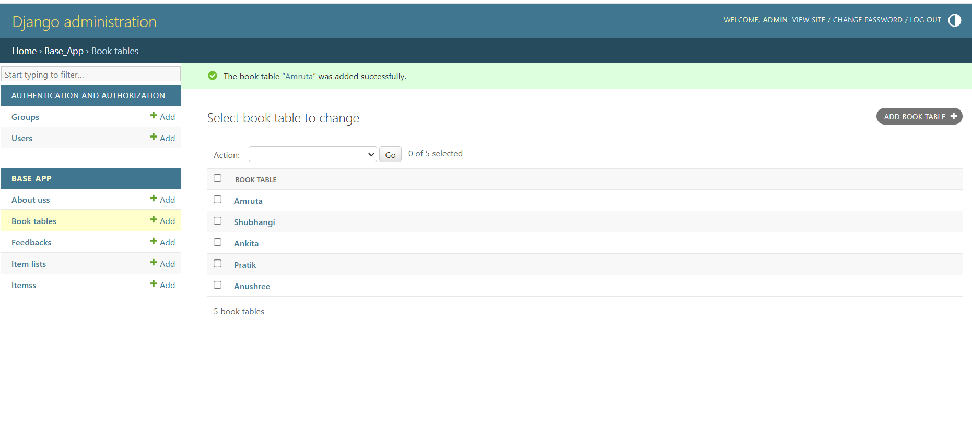
Screenshots – Book Table(change)

Slide 20
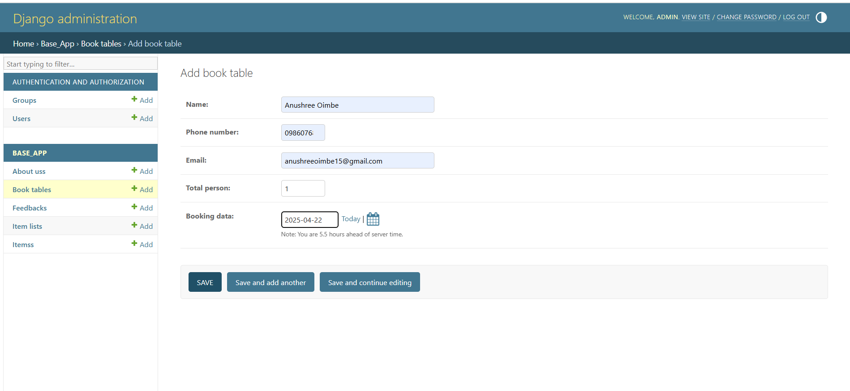
Screenshots – Add BookTable

Slide 21
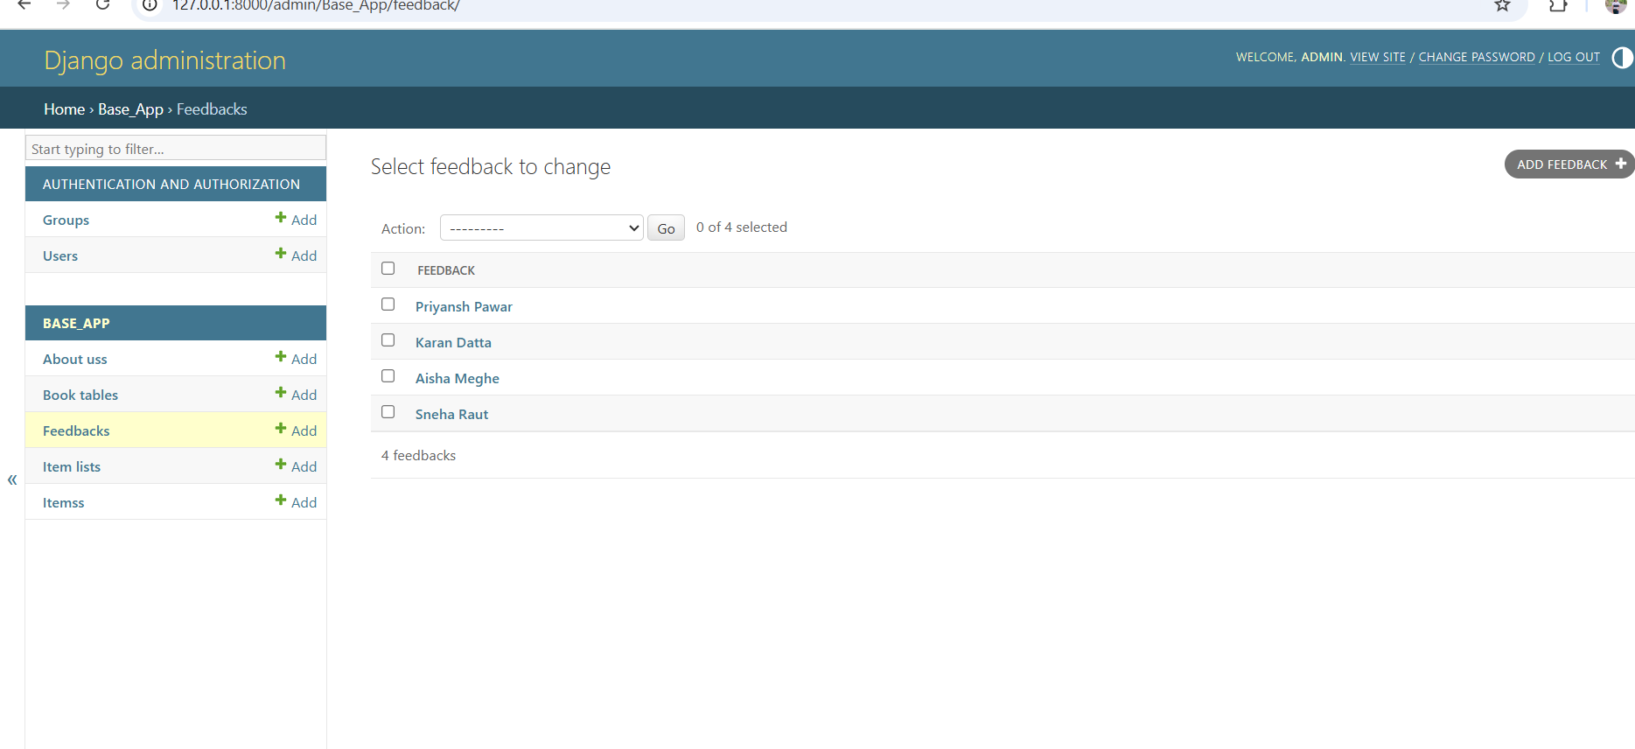
Screenshots – Feedback(change)

Slide 22
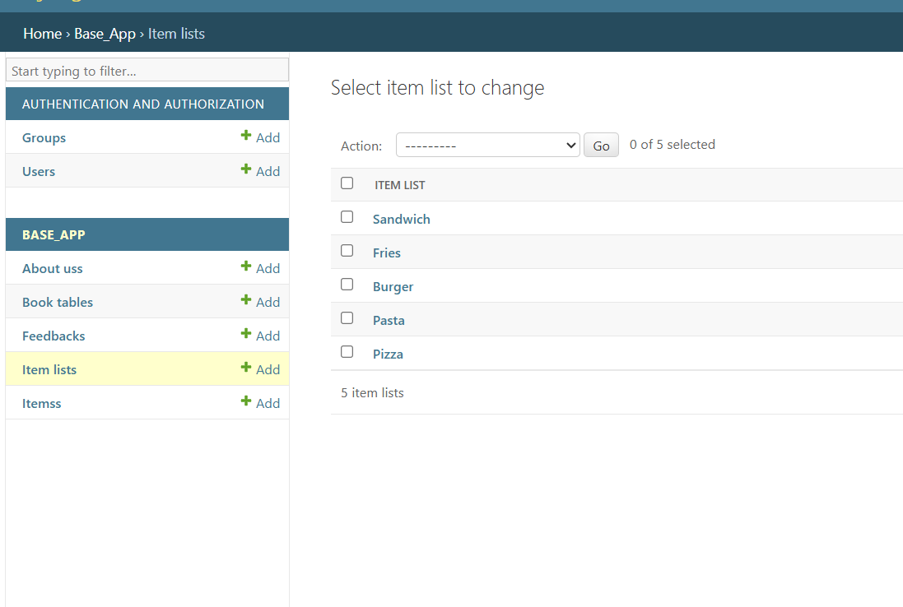
Screenshots – Item Lists(Change)

Slide 23
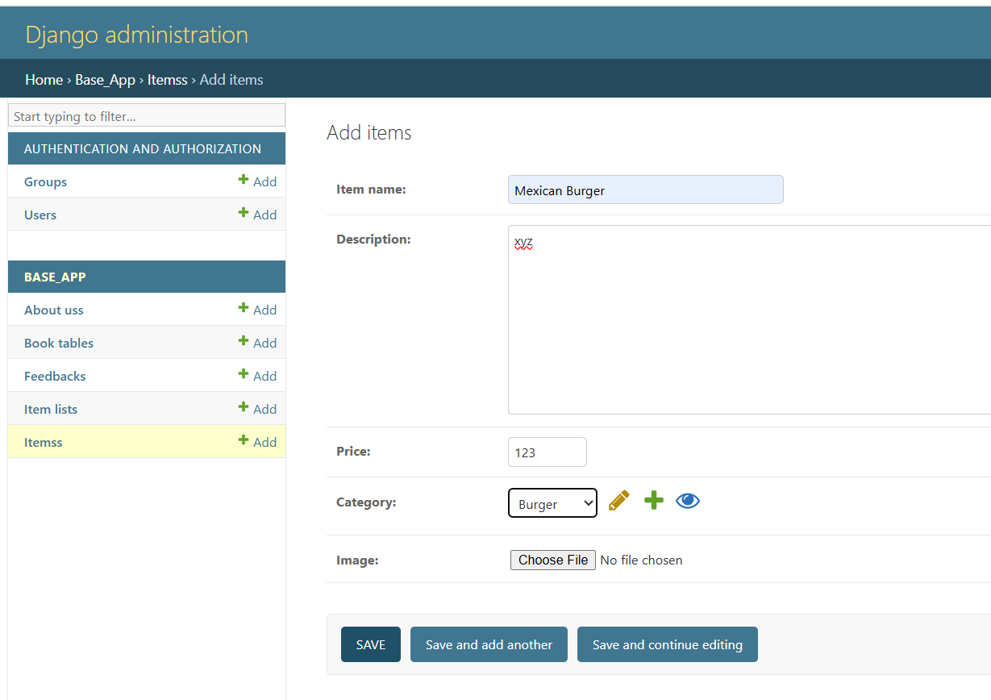
Screenshots – Items(Add)

Slide 24
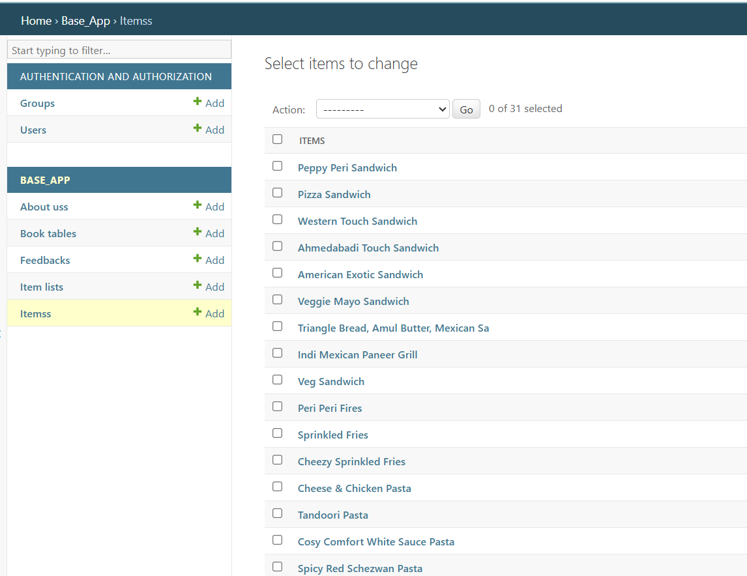
Screenshots – Items(change)

Slide 25
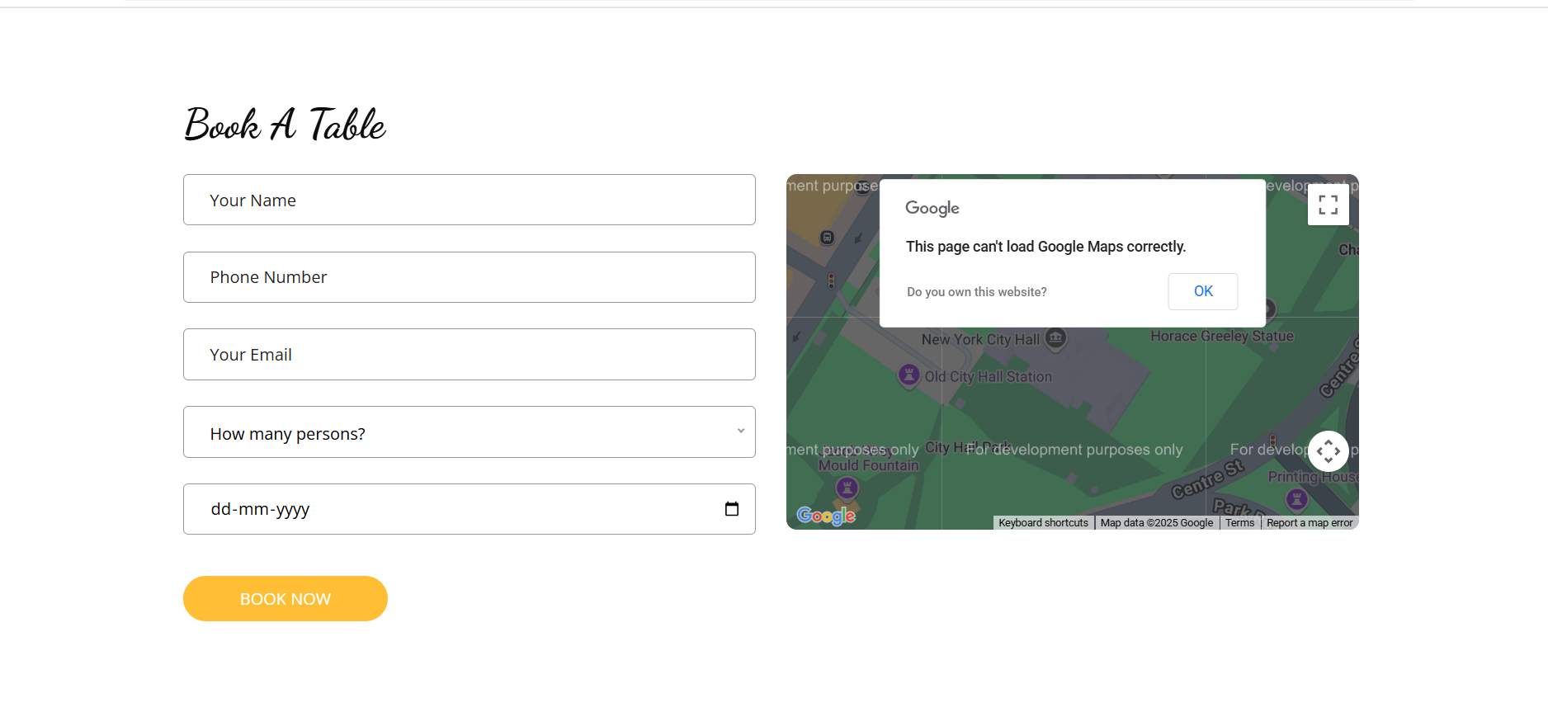
Book a Table
Feane’s

Slide 26
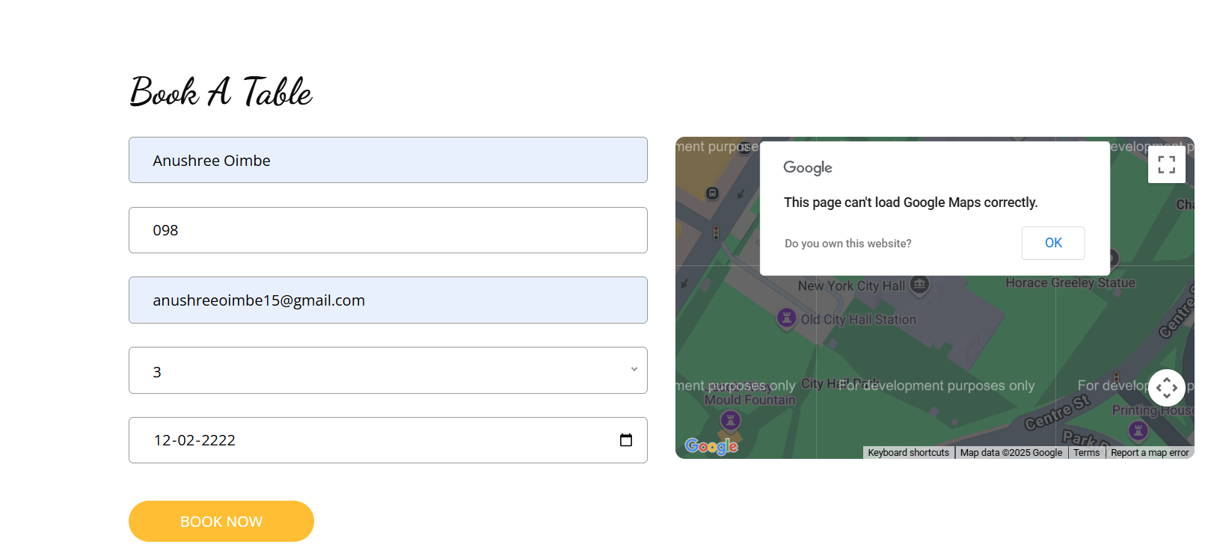
Book a Table
Feane’s

Slide 27
Conclusion & Future Scope
Future Enhancements:
Online payment integration
Delivery tracking
Customer reviews and ratings
Highlights:
Simple and intuitive UI
Fully functional admin control
Real-time order processing

Slide 28
THANK YOU
Do Visit Again...

